Slide 1
MLA 8 Citations

Slide 2
Parts of an MLA Citation
Author.
Title of source.
Title of container (if the source is part of a larger network such as Youtube or Tiktok),
Other contributors,
Version,
Number,
Publisher,
Publication date,
Location.
Question: when might you need to use the Title of Container citation piece?
Notes:
🍐 This is a Pear Deck Text Slide
🍐 To edit the type of question, go back to the "Ask Students a Question" in the Pear Deck sidebar.

Slide 3
Book Citations
Author Last Name, First Name. Title of Book. Edition, Publisher, Publication date.
Examples:
Hatfield, Charles, et al., editors. The Superhero Reader. University Press of Mississippi, 2013.
If the author is unknown:
Beowulf. Translated by Alan Sullivan and Timothy Murphy, edited by Sarah Anderson, Pearson, 2004.

Slide 4
Website
Author Last Name, First Name. "Page title." Website title, contribution by First Name Last Name, Publisher, Publication date, URL.
Note: the website publisher is not required if it is the same publisher as the website title. Do not include http:// or https:// for URLs.
Robertson, Andy. "Finding the meaning in video games: Yes, they have value beyond entertainment and self-improvement." Ted.
Examples:
Cliffe, Nicole. "How I Pray." The Toast, 13 Oct. 2015, the-toast.net/2015/10/13/on-prayer/.

Slide 5
Online Article Format
Author Last Name, First Name. "Article Title." Publication Title, volume and/or issue number, Publication date, Pages. Database , URL or doi.
Examples:
Faraci, Devin. "I Killed Robin, the Boy Wonder." Birth. Movies. Death., 20 Apr. 2016, birthmoviesdeath.com/2016/04/20/i-killed-robin-the-boy-wonder.

Slide 6
Youtube
Last name, First name of the creator. “Title of the video or audio.” Title of the Website, role of contributors and their First name Last name, Version, Numbers, Publisher, Publication date, URL.
Example:
RotoBaller. “RotoBaller MLB: Top Fantasy Baseball Catcher Dynasty League Prospects for 2016.” YouTube, commentary by Raphael Rabe, 27 Mar. 2016, youtu.be/gK645_7TA6c.

Slide 7
You Try
Using the format below, cite your independent reading book like it is a print resource:
Author Last Name, First Name. Title of Book. Edition, Publisher, Publication date.
Notes:
🍐 This is a Pear Deck Text Slide
🍐 To edit the type of question, go back to the "Ask Students a Question" in the Pear Deck sidebar.

Slide 8
In-Text Citation Rules
In-text citations are how you, as a writer, provide evidence for your paper.
In-text citations rely on a few properties to work properly, however, the structure requires something called a SIGNAL PHRASE.
SIGNAL PHRASES lead into your quotes and can range from
In the study, ____ (Study title), they determined that “QUOTE”(Author and pg number).
OR
_______ (author’s name) explored the idea of familiarity with content breeds better understanding of text because “QUOTE” (pg number).

Slide 9
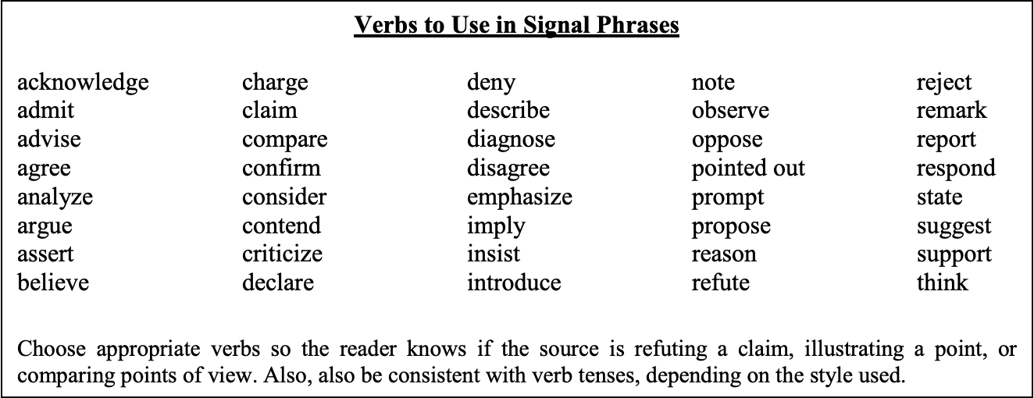
Common Signal Phrases
Examples:
a) Serrano and Coronado state, “…” (87). b) As Joe Molina notes, “…” c) Patti Buenrostro, Associate Professor of Spanish Literature, contends “…” (4). d) “…,” states Carlos Fuentes, “but …” (141). e) “…,” according to TAMIU President Dr. Ray Keck (12). f) Television news broadcaster Roy Herrera offers another perspective: “…” (10).

Slide 10
In Text Citation
One study found that “the listener's familiarity with the topic of discourse greatly facilitates the interpretation of the entire message” (Gass and Varonis 85).
Gass and Varonis found that “the listener’s familiarity with the topic of discourse greatly facilitates the interpretation of the entire message” (85).

Slide 11
You Try
Take the following quote and information and turn it into an in-text citation.
Book Title: The Radium Girls: The Dark Story of America’s Shining Women
Author: Moore, Kate
Quote: The Doctors’ autopsy findings gathered wide publicity; the girls’ fight for justice was slowly becoming famous. And it was this publicity that now brought another girl to Berry’s office, though she did not sign with him at the time.
Page: 199
Notes:
🍐 This is a Pear Deck Text Slide
🍐 To edit the type of question, go back to the "Ask Students a Question" in the Pear Deck sidebar.

