Slide 1
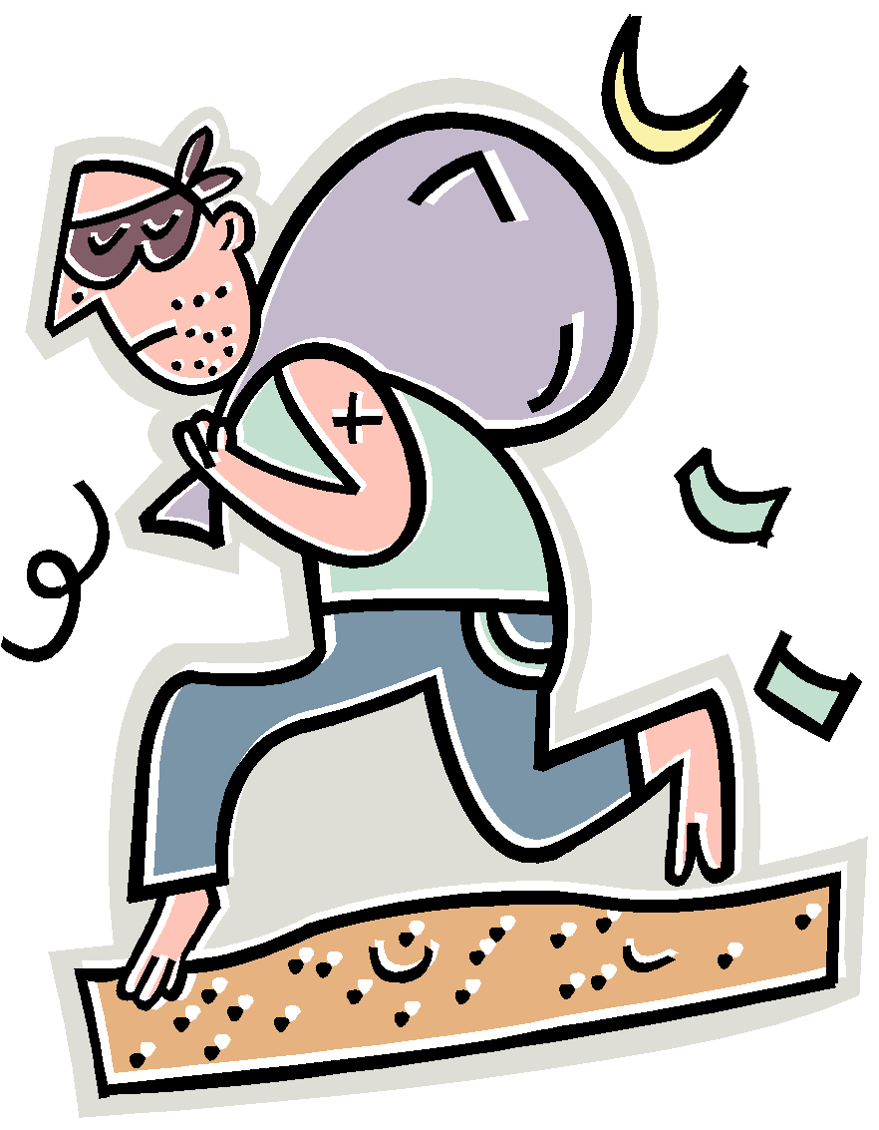
PLAGIARISM
According to the Merriam-Webster Online Dictionary, to "plagiarize" means
*to steal and pass off (the ideas or words of another) as one's own
*to use (another's production) without crediting the source
*to commit literary theft
*to present as new and original an idea or product derived from an existing source.
In other words, plagiarism is an act of fraud. It involves both stealing someone else's work and lying about it afterward.
Ideas and words

Slide 2
True or False
Plagiarism is cutting and pasting a sentence from a website and then changing a few of the words.
Notes:
🍐 This is a Pear Deck Multiple Choice Slide. Your current options are: A: True, B: False,
🍐 To edit the type of question or choices, go back to the "Ask Students a Question" in the Pear Deck sidebar.

Slide 3
True or False
Plagiarism is cutting and pasting a sentence from a website and then changing a few of the words.
TRUE
This is the most common way people believe plagiarism occurs. - http://www.plagiarism.org/plagiarism-101

Slide 4
True or False
If you recycle or reuse your older sister’s project with her permission, that’s okay.
Notes:
🍐 This is a Pear Deck Multiple Choice Slide. Your current options are: A: True, B: False,
🍐 To edit the type of question or choices, go back to the "Ask Students a Question" in the Pear Deck sidebar.

Slide 5
True or False
If you recycle or reuse your older sister’s project with her permission, that’s okay.
False
Plagiarize is defined as: to use the words or ideas of another person as if they were your own words or ideas. (even if they give you permission) - http://www.merriam-webster.com/dictionary

Slide 6
True or False
You can copy and paste a sentence written by someone else as long as you put quotation marks around it.
Notes:
🍐 This is a Pear Deck Multiple Choice Slide. Your current options are: A: True, B: False,
🍐 To edit the type of question or choices, go back to the "Ask Students a Question" in the Pear Deck sidebar.

Slide 7
True or False
You can copy and paste a sentence written by someone else as long as you put quotation marks around it.
False
This is called an incomplete citation. You need to give it proper citation by including the attribution of the source…i.e., acknowledgement of the source.- http://en.writecheck.com/plagiarism-quiz

Slide 8
True or False
It is considered plagiarism if you use an image or song found online without providing the citation.
Notes:
🍐 This is a Pear Deck Multiple Choice Slide. Your current options are: A: True, B: False,
🍐 To edit the type of question or choices, go back to the "Ask Students a Question" in the Pear Deck sidebar.

Slide 9
True or False
It is considered plagiarism if you use an image or song found online without providing the citation.
True
Plagiarism is using ANY words, objects or ideas to pass off as your own.
This includes using images, video, or music found online without permission and appropriate citations. (cont.)

Slide 10
True or False
If you use an image found online without proper citation, that’s plagiarism.
True
There are exceptions. Images, video, and music that are considered to be in the public domain or considered copyright free do not require permission to use. However, you still need to provide proper citation. http://www.plagiarism.org/plagiarism-101

Slide 11
True or False
It’s okay to take a photograph found online and use it for an art project.
Notes:
🍐 This is a Pear Deck Multiple Choice Slide. Your current options are: A: True, B: False,
🍐 To edit the type of question or choices, go back to the "Ask Students a Question" in the Pear Deck sidebar.

Slide 12
True or False
It’s okay to take a photograph found online and use it for an art project.
False
You are still plagiarizing from the person who originally took the picture, even though it is popular to do so. You can look at other images and use them as reference points but you can not copy or reproduce it as your own.
http://www.plagiarism.org/plagiarism-101

Slide 13
True or False
You don’t have to worry about citations when including “common knowledge” facts in your reports such as President Washington was the first U.S. President.
Notes:
🍐 This is a Pear Deck Multiple Choice Slide. Your current options are: A: True, B: False,
🍐 To edit the type of question or choices, go back to the "Ask Students a Question" in the Pear Deck sidebar.

Slide 14
True or False
You don’t have to worry about citations when including common knowledge facts in your reports such as President Washington was the first U.S. President.
True
Common knowledge or general reference sources do not have to be cited. - http://en.writecheck.com/plagiarism-quiz

Slide 15
True or False
Paraphrasing means to summarize someone else’s ideas in your own words. Paraphrasing, with proper citations, is a good practice to use to avoid plagiarism.
Notes:
🍐 This is a Pear Deck Multiple Choice Slide. Your current options are: A: True, B: False,
🍐 To edit the type of question or choices, go back to the "Ask Students a Question" in the Pear Deck sidebar.

Slide 16
True or False
Paraphrasing means you summarize someone else’s ideas in your own words. Paraphrasing, with proper citations, is a good practice to use to avoid plagiarism.
True
Paraphrasing is a legitimate way, with proper documentation, to include other people’s thoughts and ideas into your own work. - https://owl.english.purdue.edu/owl/resource/619/1/

Slide 17
True or False
It’s okay to use another person’s interpretation of a piece or artistic style as one’s own.
Notes:
🍐 This is a Pear Deck Multiple Choice Slide. Your current options are: A: True, B: False,
🍐 To edit the type of question or choices, go back to the "Ask Students a Question" in the Pear Deck sidebar.

Slide 18
True or False
It’s okay to use another person’s interpretation of a piece or artistic style as one’s own.
False
It doesn’t matter if you are “borrowing” from someone’s video, play, performance, webpage, email, tweet, post, song, conversation, etc…..if it is not your own idea, it’s plagiarism.
http://www.plagiarism.org/plagiarism-101

Slide 19
In short…...
http://libguides.rockhurst.edu/collegereadiness/plagiarism

Slide 20
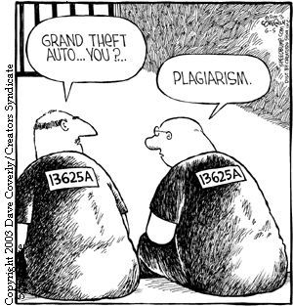
What can happen
Reputation could be ruined.
Public shaming in newspaper articles and social media postings
Assignment can be rejected
Failure in the course
Expulsion from the university or college
Banned from competition
Loss of awards
Some people have experienced:
Loss of work and reputation
Loss of degree
Fines, sometimes in the thousand dollar range.
Loss of prestigious awards
Broken contracts
https://s-media-cache-ak0.pinimg.com/736x/81/f2/7c/81f27c20bf1e1fd8d75e856e3d8970e0.jpg

Slide 21
Examples
Damaged the reputation of University of North Carolina star football player.
http://sports.yahoo.com/blogs/ncaaf-dr-saturday/unc-erik-highsmith-caught-plagiarizing-11-olds-011818599--ncaaf.html
CNN reporter Fareed Zakaria and Fox News pundit Juan Williams both were caught and had to publicly apologize for plagiarism.
Kaavya Viswanathan’s first novel and book deal was subsequently withdrawn after it was discovered she had plagiarized at least five other books.
Robin Thicke and Pharrell Williams were ordered to pay millions to the Marvin Gaye estate after being sued for Blurred Lines plagiarism.

Slide 22
More examples
Two of German Chancellor Merkle’s cabinet members have had to step down after reports of plagiarism scandals involving published articles.
9 students at Emporia State University were discovered to have plagiarized assignments and punished with 4 failing the assignment, 3 failing the course and 2 being expelled.
A Florida high school principal found himself in hot water for plagiarizing a speech for graduation he had found on Youtube.
The winner of “Ellen’s Design Challenge” on HGTV, Tim McClellan was caught plagiarizing his final project. The television show disqualified him live on National TV and awarded the prize instead to the runner-up.

Slide 23
What’s So Wrong with Plagiarism?
What if:
Your architect cheated his way through math class. Will your new home be safe?
Your lawyer paid for a copy of the bar exam to study. Will the contract she wrote for you stand up in court?
The accountant who does your taxes hired someone to write his papers and paid a stand-in to take his major tests? Does he know enough to complete your tax forms properly?
You’ve had someone else write all of your papers but you now need to take the ACT to get into college.
(Lathrop and Foss 87)

Slide 24
Guidelines for Avoiding Plagiarism
Use your own words and ideas. Give credit for copied, adapted, or paraphrased material.
Avoid using others' work with minor "cosmetic" changes.
There are no "freebies."
“Common knowledge” is okay.

Slide 25
Paraphrasing
Paraphrasing means rephrasing the words of an author, putting his/her thoughts in your own words. When you paraphrase, you rework the source’s ideas, words, phrases, and sentence structures with your own. Like quotations, paraphrased material must be followed with in-text documentation and cited on your Works-Cited page.
Paraphrase when:
You plan to use information on your note cards and wish to avoid plagiarizing;
You want to avoid overusing quotations;
You want to use your own voice to present information.
Carol Rohrbach and Joyce Valenza

Slide 26
Quoting
Quotations are the exact words of an author, copied directly from a source, word for word. Quotations must be cited!
Use quotations when:
You want to add the power of an author’s words to support your argument;
You want to disagree with an author’s argument;
You want to highlight particularly eloquent or powerful phrases or passages;
You are comparing and contrasting specific points of view;
You want to note the important research that precedes your own.
Carol Rohrbach and Joyce Valenza

Slide 27
Summarizing
Summarizing involves putting the main idea(s) of one or several writers into your own words, including only the main point(s). Summaries are significantly shorter than the original and take a broad overview of the source material. Again, it is necessary to attribute summarized ideas to their original sources.
Summarize when:
You want to establish background or offer an overview of a topic;
You want to describe knowledge (from several sources) about a topic;
You want to determine the main ideas of a single source.
Carol Rohrbach and Joyce Valenza

Slide 28
As you take notes:
Include any direct quotes or unique phrases in quotation marks or mark with a big Q and make sure the speaker’s /writer’s name is identified.
Make sure you note a paraphrase with the writer’s name and mark it with a big P
Include page numbers and source references so you can go back and check for accuracy as you write.

Slide 29
Check for Understanding
What are two ways you can avoid getting in trouble for plagiarism?
Notes:
🍐 This is a Pear Deck Text Slide
🍐 To edit the type of question, go back to the "Ask Students a Question" in the Pear Deck sidebar.

Slide 30
Bibliography
Steve Garwood Presentation
www.sdst.org/shs/library/powerpoint/plagiarism.ppt
http://en.wikipedia.org/wiki/List_of_plagiarism_incidents
http://www.plagiarism.org/plagiarism-101/prevention/

