Slide 1
Integrating Quotes for Evidence

Slide 2
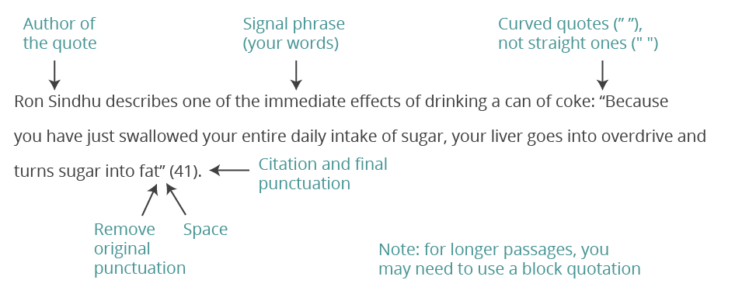
Parts of an integrated quote:
Author
Signal Phrase
Quote
Citation

Slide 3
3 Ways to Integrate Quotes
Use an introductory phrase separated from the quotation with a comma.
Introduce the quotation with a sentence that sets it up by using a colon (:)
Splice the quotation into the flow of your own sentence.

Slide 4
Standard Integration
According to the article “Female Superhero Representation in Comics” by VelvetRose on the comic social network site “The Artifice” the readership statistics in “July of 2015, women made up approximately 42% of American Facebook users who ‘like’ comics and anything associated with them. Eventbrite states that 40% of people who attended fan conventions in 2014 were female” (Female Superhero Representation in Comics).

Slide 5
Quote Splice
This contrasts with the 38% of males who are “fans” of the female led comics. However, overall, there are still more male purveyors of comics than women according to statistics also done on Graphic Policy’s Brett Schenker in February 2014, out of 24,000,000 comic book fans “men accounted for 53.64% and women for 42.73%. This month women made some gains, now accounting for 46.67% of the population and men 54.17%” (Facebook Fandom Spotlight: Who are the US comic fans?, Schenker).

Slide 6
Block Quote
When discussing how multimodality has shifted pedagogy, Lasisi Ayaji, a professor at California State University, stated in her article, “Innovative Approaches in English-Language Arts: How Two Teachers Teach High School Students to Use Multimodal Resources for Interpretation of Romeo and Juliet and Macbeth” that
High school English-language arts (ELA) teachers are teaching at exciting times of shifts in literacy and literacy practices and learning environments characterized by new media including social networking media and mobile devices that provide youths the ability to manipulate and transform texts and adapt them to new forms. (Ayaji)

Slide 7
Block Quote with Splice
In an article for the Mary Sue, “Why Kamala Khan is the Most Important Superhero in the World” author Anthony McGlynn outlines what we believe a superhero is as:
strong, foreboding figures who have otherwordly control over themselves and their element in other to fight the good fight. Classic superheroes are, by and large, white, male (with some very notable exceptions), muscular; and each has proven their weight in worthwhile stories and historic events, to find themselves with a cult of personality that means even just their logo on an object makes that object desirable. (McGlynn)

Slide 8
Two Authors
Chuang and Roemer state that “Muslim Americans are not defined by race or nationality; they share a religious identity and are predominantly composed of first- or second-generation immigrants” which parallels the way that Kamala represents her Pakistani heritage, other Muslim characters in the series are of different nationality but share the same values (Chuang & Roemer).

Slide 9
Check for Understanding
What are two examples of quote integration that you learned today?
Notes:
🍐 This is a Pear Deck Text Slide
🍐 To edit the type of question, go back to the "Ask Students a Question" in the Pear Deck sidebar.

Slide 10
Practice
Take the following quote and write it as if you’re integrating the evidence into an essay on radium poisoning in the 1920s.
Book Title: The Radium Girls: The Dark Story of America’s Shining Women
Author: Kate Moore
“Many of the women were ‘unfit’ when they started dial-painting [radium] and as an excuse had unfairly impugned the firm” (140).
Notes:
🍐 This is a Pear Deck Text Slide
🍐 To edit the type of question, go back to the "Ask Students a Question" in the Pear Deck sidebar.

